Slide 1







SQL for Data Science Capstone Project Olympics Dataset
Shay Hegarty
03/20/2022

Slide 2



OUTLINE
Executive Summary
Questions
Hypothesis/Methodology
ERD
Results
Visualization – Charts
Discussion
Findings
Conclusion

Slide 3

EXECUTIVE SUMMARY
Review the SportsStats dataset on Olympics information for the past 120 years.
Dive deeper into seeing how countries are consistently performing each year.
Compare how these countries perform from Summer games to the Winter games.
Are there specific countries dominating both areas.
Look into data demographic information on the Olympians and see how they have changed over the years and more specifically how the males dominated the Olympics in the early years but its starting to level out now.

Slide 4

Questions
Is there more men or women competing in the Olympics? How has this changed over time?
Which countries are always successful?
How has the age gap changed over the years?

Slide 5
Hypothesis
Is there more men or women competing in the Olympics? How has this changed over time? I would think there has been more men every single year since the start of the Olympics.
Which countries are always successful? I am presuming it will be the largest countries such as USA, China etc.
How has the age gap changed over the years? I would imagine the age gap being quite significant but the overall average being in the 20-30s.

Slide 6

Approach/Methodology
Analysis was completed using the SportsStats ‘Olympics Dataset – 120 years of data’
Data was then wrangled/cleaned by investigating missing values, removing duplicates and normalizing the data
Data was then explored, and any outliers were reviewed
Visualizations were then created to determine relationships within the data
Finally, I dove deeper into the data to find the correlation and relationships between the data

Slide 7
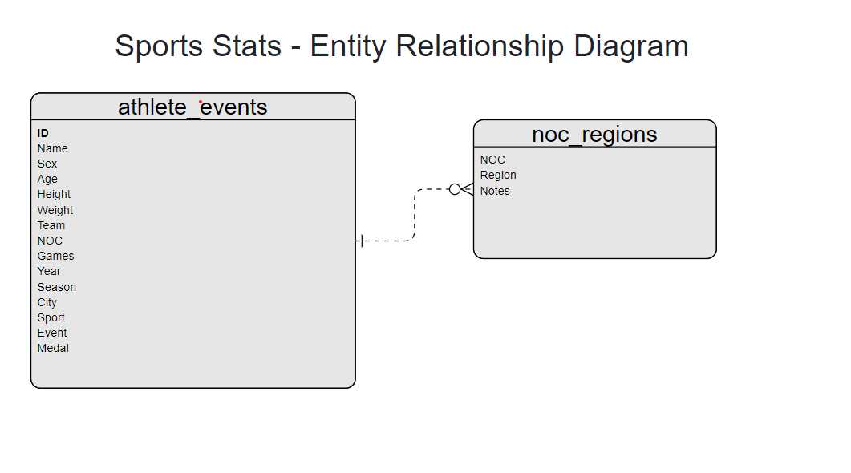
ERD

Slide 8
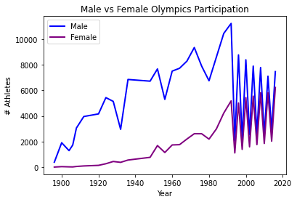
Male vs Female Participation

Slide 9
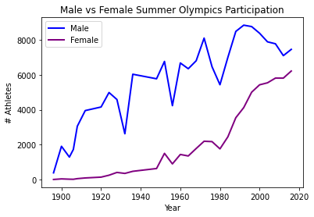
Male vs Female Participation Summer Games
Large discrepancies between male and female participation in the early years
1980s was a huge turning point
Participation rate for females is steadily going up since the 1980s and will hopefully level out completely in the years to come.

Slide 10
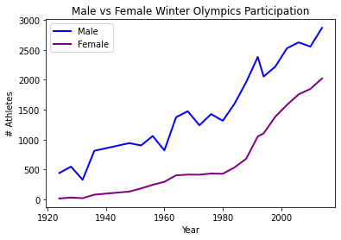
Male vs Female Participation Winter Games
Similar to the summer games there is a large discrepancies between male and female participation in the early years
1980s -1990s was a huge turning point for the winter games also.
Participation rate for females is steadily going up since the 1980s and will hopefully level out completely in the years to come.

Slide 11
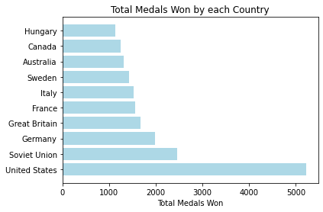
Top 10 Countries by Medals Won

Slide 12
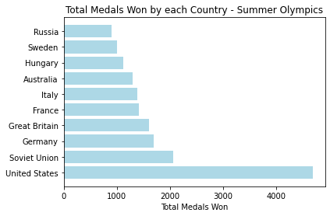
Countries by Medals Won Summer Games
As expected in our hypothesis USA is dominating the field when it comes to medals being awarded for the Summer Games.

Slide 13
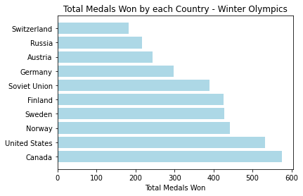
Countries by Medals Won Winter Games
When it comes to the Winter games USA is still a massive competitor but its not comparable to their lead in the summer Olympics.
Seeing the Scandinavian countries such as Norway, Sweden and Finland which is expected for the Winter games.

Slide 14
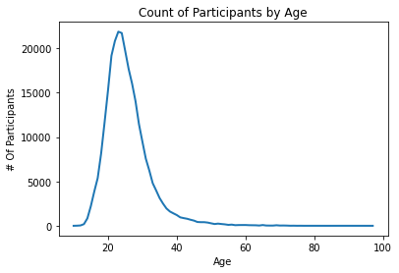
Age of Participants
Youngest Olympian is listed at 10years old.
Average ages are between 20 – 30 which was predicted.

Slide 15
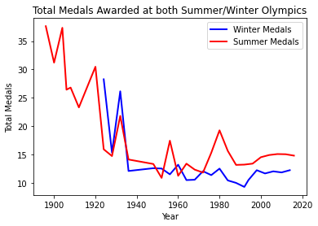
Total Medals Awarded Summer vs Winter games
Early years there were different amounts of medals distributed for each class
Eventually this levelled out and it looks like the same amount of medals get distributed

Slide 16
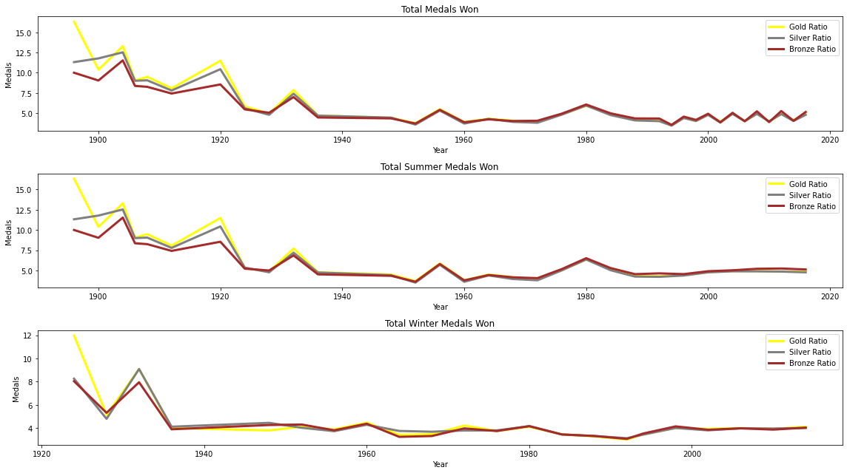
Total Medals Awarded Summer vs Winter games

Slide 17
FINDINGS STD and CORRELATION
Standard Deviation:
Standard Deviation for Summer Olympics Medals = 475.323015441357
Standard Deviation for Winter Olympics Medals = 152.56899942903493
From 1924 to 2016, as the standard deviation in the summer Olympics is about 3 times that in the winter Olympics, country performance by year change more in Summer Olympics.
The Pearon correlation coefficient between the total number of medals in the winter and summer Olympics from 1924 to 2016, is 0.94, which is highly positive. Therefore, the performance of a country in winter Olympics is highly correlated to that in summer Olympics.

Slide 18

DISCUSSION
What further insights can we determine from this dataset?
Investigate into the spike in the 1980s for the amount of medals that were awarded.

Slide 19

CONCLUSION
Is there more men or women competing in the Olympics? How has this changed over time? I would think there has been more men every single year since the start of the Olympics.
Which countries are always successful? I am presuming it will be the largest countries such as USA, China etc.
How has the age gap changed over the years? I would imagine the age gap being quite significant but the overall average being in the 20-30s.

